Slide 1
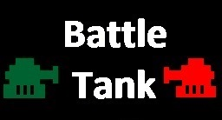
ECE 540 Final Project
Team Members: Hai Dang
Mark Chernishoff
Aditya Pawar

Slide 2
Gameplay
Purpose: To destroy opposing tank
Rules: If opposing tank destroyed 3 times, that players wins
I/O
Keyboard is used to control tanks and firing
Sound generated for each screen
All maps and icons are output to VGA screen

Slide 3
Responsibilities
Mark Chernishoff: Game_screen, Picoblaze
Hai Dang: Audio PWM, keyboard
Aditya Pawar: Image Generation.

Slide 4


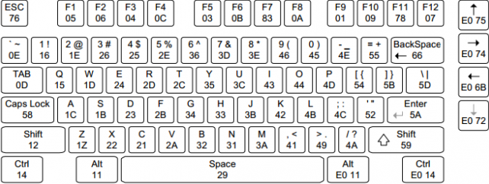

Block Diagram
DTG
Colorizer
Screen Generator
Switch Interface
Picoblaze switch.v
Audio
Interface
Audio
PWM
Game Screen
Keyboard

Slide 5
Game Screen Generation
Block ROMS hold color information
for tanks, bullets, explosion, and
background
Controls tank and bullet location
and orientation
When bullet location is at opposing
tank location an explosion occurs and
score increases
When score for either player reaches 3 a
signal is sent to Switch Interface to change
screens

Slide 6
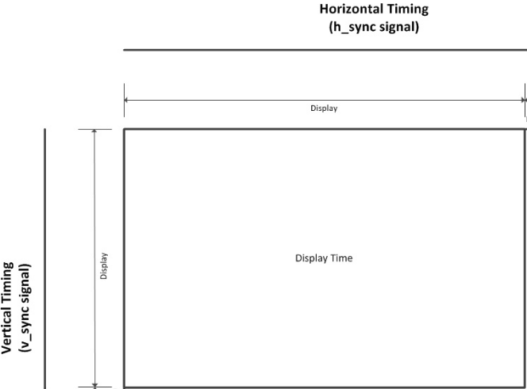
VGA
Resolution 1024 x 768
Change Horiz_Pixels = 1024 (DTG)
Change Vert_Pixels = 768 (DTG)
Input Clock: 45 MHz
Image Generation
First screen (128x96)→ Scale 8
Game screen (512x384) → Scale 2
Game over screen (128x96) → Scale 8

Slide 7


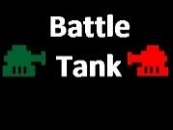
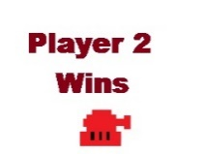
Switch Interface
‘N’ pressed
State0
First Screen
‘Y’ pressed
State1
Game Screen
State 2
Player Wins
Player Screen > 0
‘Y’ pressed
Game Screen
Player 1 or 2 wins
Colorizer
First Screen

Slide 8
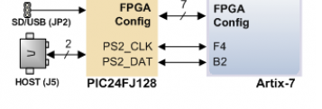












Keyboard Interface
kGame Screen
Block diagram
CLK 50 MHz
KKeyboard module
PS2_CLK
PS2_DATA

Slide 9


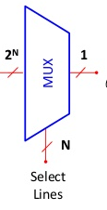
Audio Pulse-Width Modulation
ROM Block
CLK 8KHz
Resample 8K
COE file
Audio Interface
ROM Block
Address
COE file
Audio PWM
AUD_PWM
Dout
Dout
Keyboard
AUD_SD
COE file
ROM Block

Slide 10
Challenges and Improvement
Challenges
Brom issue
Animation ( Noise pixels affect tank moving)
Enhancement
Keyboard interface ( Using button and switchs in proposal)
Audio and Channel for Audio ( Not mention in proposal)
Improvement
Using MicroSD to solve Bram issue
Using Android app instead of keyboard
Create bonus items (Ex. Increase speed tank, change type of bullets,…)
Create more maps and let player choose
Change style game by writing AI bot ( 2 tanks fights these AI bot)

Slide 11

Thank you !!!
Question and Answer
Demo

